Slide 1




LEAF DISEASE DETECTION
B.TECH 2022-26 5th SEM AI & ML
MINOR PROJECT - I
PRESENTED BY:
MALAYA KUMAR JENA(22CSEAIML028)
SUNIL MOHANTY(22CSEAIML093)
SAI SWORUP MOHANTY(22CSEAIML048)
UNDER THE GUIDANCE OF:
Mr. VISHAL KUAMR SWAIN
BACHELOR IN TECHNOLOGY
DEPARTMENT OF COMPUTER SCIENCE & ENGINEERING
SCHOOL OF ENGINEERING AND TECHNOLOGY
GANDHI INSTITUTE OF ENGINEERING & TECHNOLOGY UNIVERSITY,

Slide 2



CONTENTS
OBJECTIVE
PROJECT OVERVIEW
SOFTWARE & HARDWARE REQUIREMENTS
ADVANTAGES
FLOW CHART
SCREENSHOT
CONCLUSION
LAPTOP PRICE PREDICTION

Slide 3
OBJECTIVE
The objective of the leaf disease detection project is to develop an easy-to-use tool that helps farmers spot diseases on plant leaves early. By detecting diseases quickly, the tool can help prevent them from spreading and damaging crops. This project aims to make farming more efficient by reducing the need for manual inspections and guesswork. It also seeks to protect crops and increase harvests by providing accurate information about the disease, so farmers can take the right actions. Additionally, the tool promotes healthier plants and reduces the use of harmful chemicals, supporting more sustainable farming practices.

Slide 4


PROJECT OVERVIEW
The leaf disease detection project aims to create a tool that helps farmers quickly identify diseases on plant leaves using technology like image recognition. Farmers can take pictures of the leaves, and the tool will analyze them to detect any signs of disease. This early detection allows farmers to act quickly, preventing the disease from spreading and protecting their crops. The project focuses on making the tool easy to use, even for those with little technical knowledge, and aims to improve crop health, increase yields, and support sustainable farming by reducing the need for excessive pesticide use.

Slide 5
SOFTWARE & HARDWARE REQUIREMENTS
Software: Python
Libraries: Pandas, NumPy , Matplotlib, Seaborn , Scikit-learn , TensorFlow
Keras , Streamlit
Hardware: RYZEN 5, Windows 11
RAM (8 GB)
SSD (512 GB)
Code Editor: Jupyter Notebook
Spyder , Google Collab

Slide 6
ADVANTAGES
1. Early Problem Identification: It helps detect diseases in plants early, preventing the spread of the disease to other plants.
2. Improves Crop Yield: By identifying diseases early, farmers can take quick action to protect their crops, leading to better harvests.
3. Reduces Chemical Use: Accurate disease detection means farmers can use fewer pesticides, which is better for the environment and reduces costs.
4. Saves Time and Effort: Automated detection systems can monitor plants continuously, saving farmers time and reducing the need for constant manual inspection.
5. Data-Driven Decisions: It provides valuable data that can help farmers make informed decisions about plant care and disease management.
6. Cost-Effective: Preventing diseases from spreading can save money by reducing the need for expensive treatments and minimizing crop losses.

Slide 7
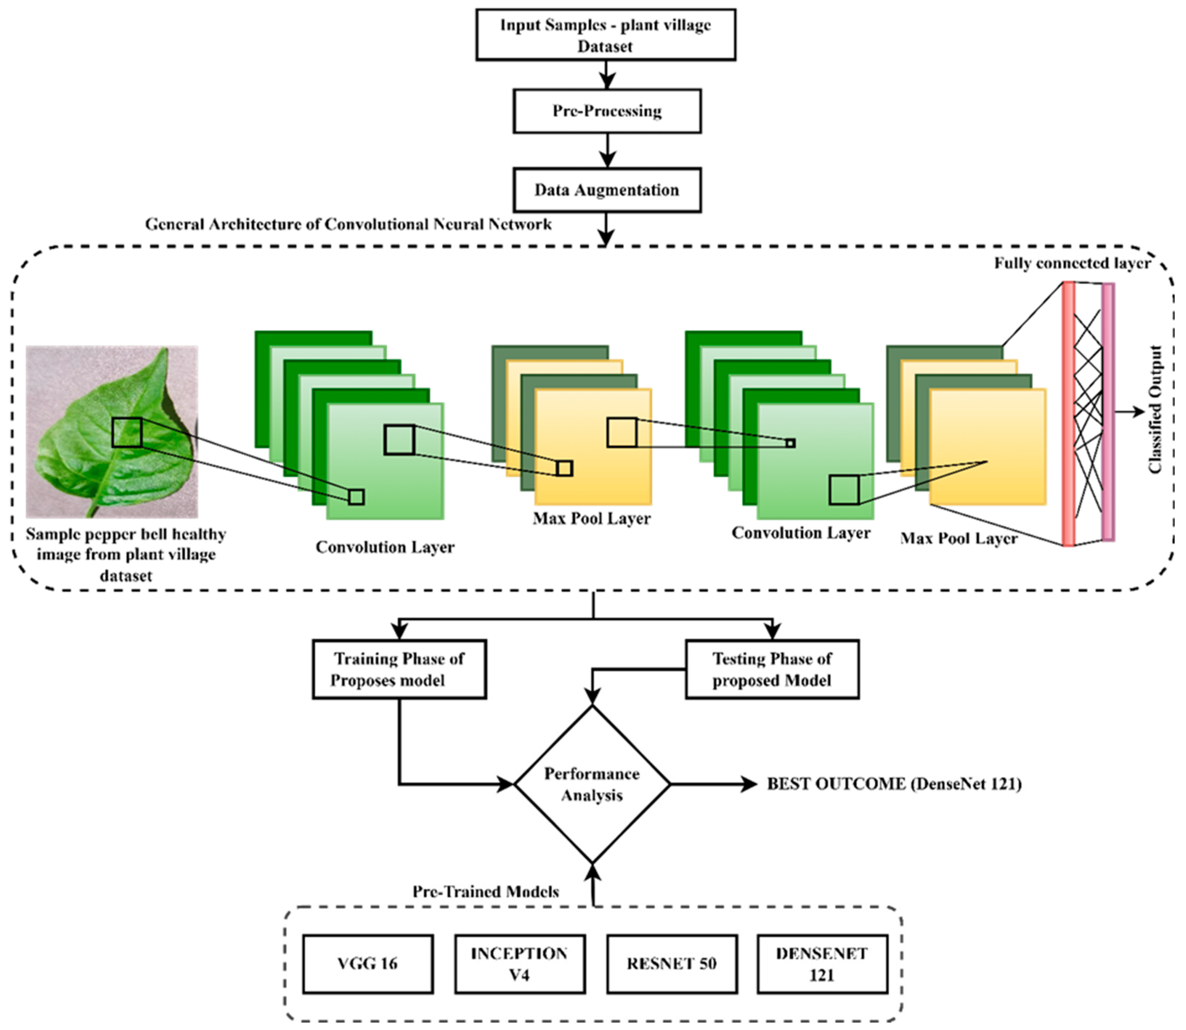
FLOW CHART

Slide 8
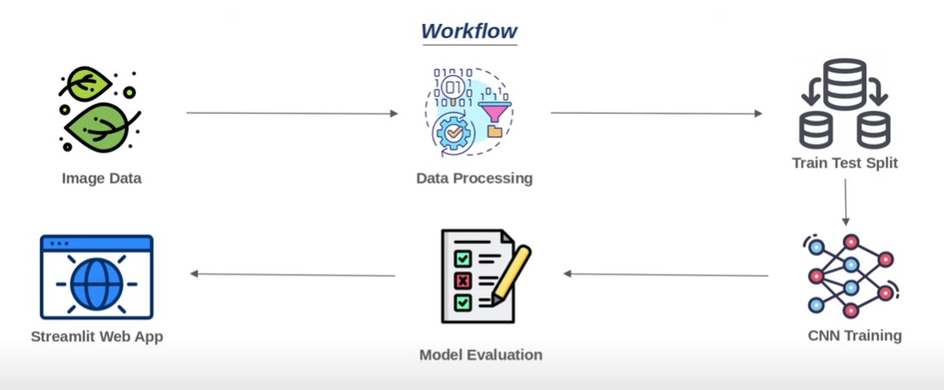
WORK FLOW

Slide 9
CONCLUSION
In conclusion, a leaf disease detection project offers significant benefits to agriculture by enabling early identification of plant diseases. This early detection allows farmers to take timely action, reducing the spread of disease and minimizing crop losses. By using technology to monitor plants, the project helps improve crop yield, reduce the use of harmful chemicals, and save both time and resources. The data generated from such systems also supports more informed decision-making, contributing to sustainable farming practices. Overall, the project not only enhances productivity but also promotes environmental conservation, making it a valuable tool for modern agriculture.

